Slide 1
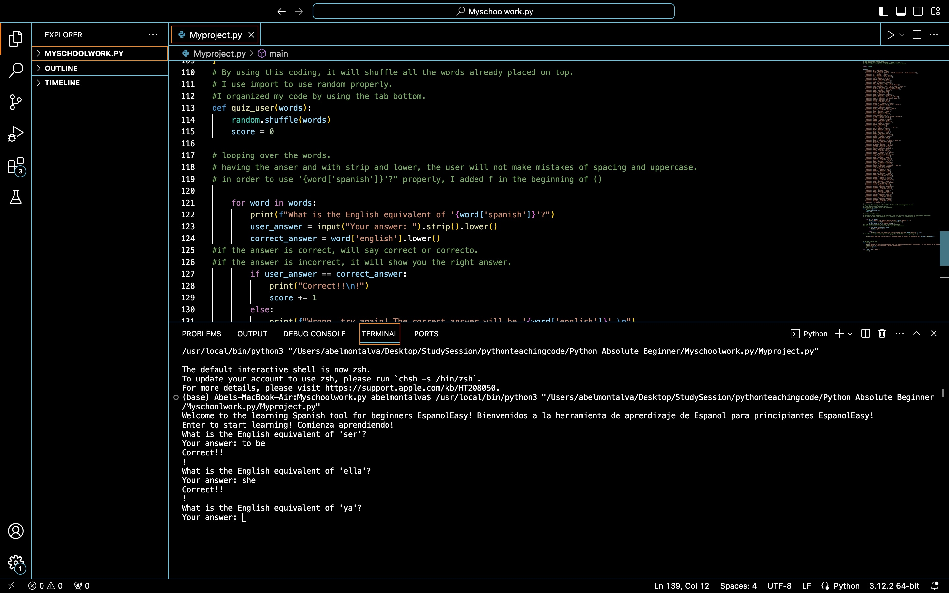



EspañolEasy
Flexible Learning Options
User-friendly Interface
Structured Learning Path
Abel Montalva
An app that it is user-friendly language learning application tailored specifically for English speakers who are beginners in learning Spanish.
Contact us:
Amontal8@students.Kennesaw.edu
License

